Slide 1
Drugs Regulations

Slide 2
Issues
G.S.R. 360(E) dated 10.04.2018: making it mandatory to submit stability studies, excipient safety etc. along with the application before grant of manufacturing license.
G.S.R. 327(E) dated 03.04.2017: in order to ensure efficacy of drugs, the applicant shall submit the result of Bioequivalence study w.r.t oral dosage form of drugs.
FDCs: New drug. CDSCO is the competent Licensing Authority. But licences issued by State Licencing Authorities. Notifications had to be issued by the GoI banning those FDCs. Now in litigation.

Slide 3
Regulatory work
Each establishment is required to be inspected annually.
Each Inspector expected to draw a minimum of 08 samples per month.
Take action concerning NSQ drugs.
Actions expected to be proportional to failures and deficiencies.
Sale of drugs without prescription and bills to be taken cognizance of.
Data about the regulatory action needs to be placed in public domain

Slide 4
Sugam- Status of implementation
In compliance to GSR 80 (E) dated 10.01.2019 manufacturers were required to upload information of licenses granted on the Sugam portal.
Large number of units are yet to upload their data.
State Drug Controller was required to verify the same. Yet to be done.
Out of more than 33500 licenses issued, just 2200 have been uploaded in last 9 months (Appx 6.5%).

Slide 5
ASR Hip Implant of J&J- compensation issue
Central Expert Committee constituted to determine the quantum of compensation.
States and UTs were required to form State Level Committees (03 states).
Report of the individual to be submitted by the State Level Committees to the Central Expert Committee.
Major issue: Delay in securing disability certificate.

Slide 6
Scheme of “Strengthening States Drug Regulatory System” in the Country
CCEA, on 12.08.2015, approved this Scheme with an outlay of Rs. 850 crore.
Upto 2019-20.
Approved BE 2019-20 is Rs. 206 crore.
Third Party evaluation of the scheme.
An agency is being engaged for this. The Agency will be visiting the states to verify the utilization of fund and the impact on Drug Regulatory system.
The exercise is to be completed by 31st December, 2019.

Slide 7
Following States/UTs have not signed MoU with MoH&FW
S.No. | Name of States | Indicative Amount (Rs. in crore)
1. | West Bengal | 67.00
2. | Chhattisgarh | 13.00
3. | Assam | 49.00
4. | Manipur | 06.00
Name of UTs
1. | Andaman & Nicobar Islands | 07.00
2. | Chandigarh | 01.00
3. | Dadra and Nagar Haveli | 08.00
4. | Daman and Diu | 01.00
5. | Lakshadweep | 01.00

Slide 8
Regulation of E-Pharmacy
Draft rules on E-Pharmacy - published on 28. 08. 2018
Registration of e-pharmacy with CLA through on line portal mandatory.
Market place model, not inventory model
Registration holder not allowed to obtain any sale licence for sale of drugs.
Sale of Narcotics, Psychotropic, Schedule X and H1 drugs are not permitted.
Inspection of e-pharmacy premises at least once in every 2 years by CLA/SLA.
Role of States:
Drug is required to be sold in accordance with the conditions of Sale licence.
SLA is required to monitor the sale of drugs to ensure compliance with the conditions of sale licence.

Slide 9
Medical Devices Roadmap
At present 24 categories of Medical Devices are regulated.
12 more categories to be included: Effective in 2020.
Govt. has proposed a roadmap for regulation of all Medical Devices in a phased manner.
Definition of Medical Devices being included under Drugs.
Initially voluntary registration period: 18 months.
Licensing:
For class A & B: After 30 months
For class C & D: After 42 months

Slide 10
Food Regulations

Slide 11
Human Resources and Institutional Systems
Posting an officer as Food Safety Commissioner exclusively.
Need for creation of posts as per norms.
Re-constitute State Level Advisory Committee and District Level Advisory Committee, and their regular meetings.
State level Appellate Tribunals need to be set up.
Participation in the Central Advisory Committee meeting of FSSAI.

Slide 12
Licensing and Compliance System
To take up special drives for identification of unregistered/ unlicensed FBOs.
IT system to be adopted for faster processing and transparency, including online payment of license fees.
Adoption of Online platform (Food Safety Compliance through Regular Inspections-FoSCoRIS)

Slide 13
Food Testing Infrastructure and Surveillance
Need to comprehensively review the state of food testing laboratories.
FSSAIs Central scheme for strengthening of laboratories.
To participate in INFOLNET (Indian Food Laboratories network) by uploading data regularly to ensure a real time National Repository is created.

Slide 14
Fortification
FSSAI is addressing micronutrient deficiencies by formulating standards for fortification of key staples viz. edible oil and milk, wheat flour and rice and salt.
Regulations notified in August 2018.
+F logo as unique identification.
122 fortified products across commodities.
17 States and 5 UTs have adopted fortification of several commodities in the safety net programmes like ICDS, MDM and PDS.
425 FSO trained across states.

Slide 15
Eat Right India- Sahi Bhojan Behtar Jeevan
'Eat Right India', built on two broad pillars of 'Eat Healthy' and 'Eat Safe”.
Robust standards & code of practices, credible food testing & effective surveillance, strengthened compliance, strong culture of self-compliance, promoting healthy diets & sustainability and empowered consumers.
Key Performance Indicators: Ease of Living through safe food and healthy diets, Ease of Doing business and trade, creation of Jobs, Skilling on food safety and hygiene, Reduction in foodborne illnesses and NCDs, Food fortification, Food loss and wastage.
Eat Right Toolkit to be used in all 1.5 lakh Health and Wellness Centres.
Frontline health workers like ANMs, mid level health providers, ASHA and Anganwadi workers, Community Resource Person etc. to be trained in the Eat Right Tool kit.
States/UTs to budget for IEC funds.

Slide 16
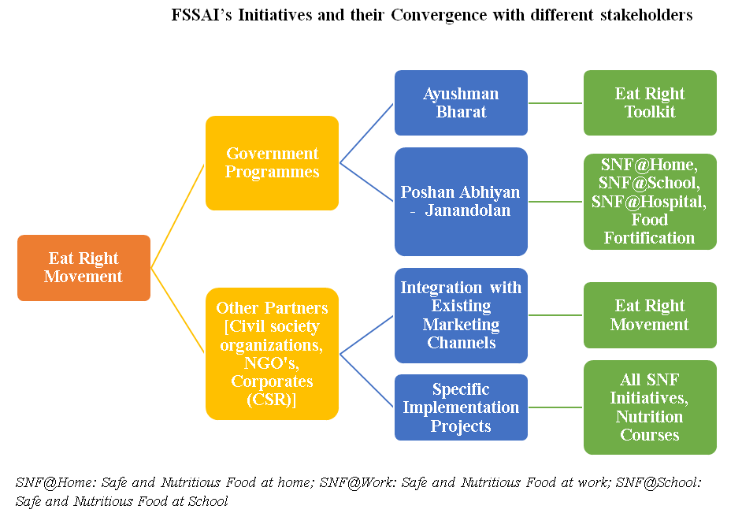
Eat Right

Slide 17
Risk Based approach on Sampling
Risk management based on risk assessment and other factors to achieve the general objectives of the FSS Act.
Focus on preventive controls.
Identify potential risk associated with the foods:
Mapping of all the food businesses with the risks associated (e.g. foods of animal origin) and identify the risk to health and do risk ranking
Establishing the priorities for risk based inspections and develop the sampling plans and intervention strategies accordingly.
Take appropriate steps to mitigate or eliminate the risk (e.g. Issue Improvement notices to FBOs, food recalls, temporary prohibition).

Slide 18
Thank You

Slide 19
Clinical Establishments Act, 2010

Slide 20
Clinical Establishments Act, 2010
States / UTs where the Act has been adopted:
Arunachal Pradesh, Himachal Pradesh, Mizoram, Sikkim, Uttar Pradesh, Uttarakhand, Rajasthan, Bihar, Jharkhand, Assam and Haryana
All Union Territories except Delhi

Slide 21
Salient Features
Coverage - All types of clinical establishments:
Therapeutic & diagnostic
Big/Small hospitals & single doctor clinics
Allopathic and AYUSH
Public and Private
Dates for adoption of Act may be different for different categories of clinical establishments and for different recognized systems of medicine (Secretary HFW letter dated 09.01.2019).
Redressal mechanism in case of grievances/ complaints for lack of services, overcharging etc.

Slide 22
Registration
Details of charges, facilities available to be prominently displayed.
Electronic medical records and EHR.
Charge rates for procedures and services within the range of rates.
Compliance to Standard Treatment guidelines.
District Registering Authority and State Council for Clinical Establishments.
Budget For Implementation through NHM State PIP.
Coordinators and Data Entry Operators in States.
Online Registration: Functional In 12 States/UTs

Slide 23
Status of Regulation in Other States where no CEA
States which have their own legislations and exempted in CEA
Other States which have their own legislations
Andhra Pradesh (erstwhile)
Maharashtra,
Delhi,
Madhya Pradesh,
Manipur,
Nagaland,
Punjab (Not implemented)
Odisha,
West Bengal (revised 2017)
Jammu & Kashmir,
Chhattisgarh,
Tamil Nadu,
Meghalaya,
Kerala,
Tripura,
Karnataka (amended in 2017)
Goa
States which neither have their own legislation and nor CEA: Gujarat

Slide 24
The Healthcare Services Personnel and Clinical Establishment (Prohibition of Violence and Damage to property) Bill, 2019.
Draft Rules published on 2nd September, 2019 giving 30 days time for stakeholders’ comments.
Bill proposes maximum imprisonment upto 10 years (Minimum is 6 months) and fine upto 10 lakh rupees as punishment for assault/ damage.
It also provides for monetary compensation for damage fo property or documents in a clinical establishment.
Offences against medical professionals will be cognizable and non-bailable in nature.
Draft sent to all Chief Secretaries also. States requested to give their comments within the prescribed time.

Slide 25
Transplantation of Human Organs Act

Slide 26
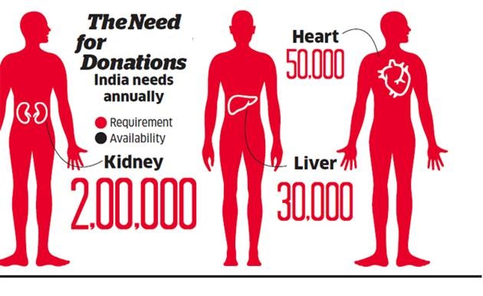
Why Organ Donation
350
350
2500
9500
2500
9,500

Slide 27
Why do We Need Deceased Donation?
Living donation alone can not fulfill requirement.
Risk of commercial transaction and potential health risk to donor in living donation.
Certain organs cannot be taken from living source.

Slide 28
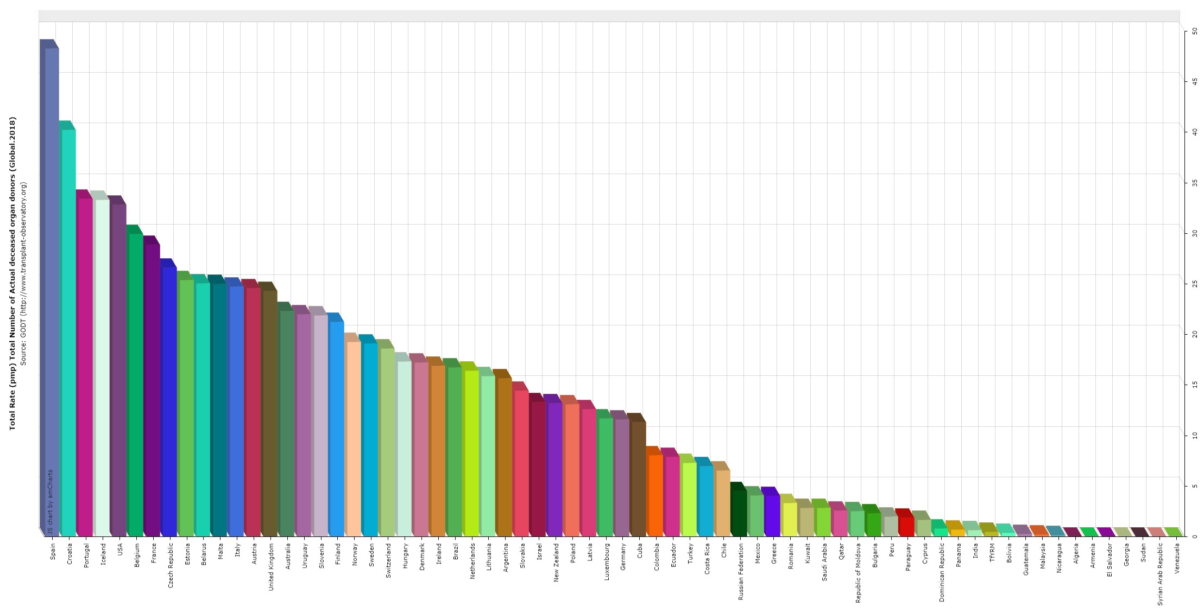
No. of Deceased Donors (PMP) GODT 2018
Spain
48.3
USA
32.8
Australia 22.3
Uk
24
India 0.65

Slide 29
For Regulation of removal, storage and transplantation of human organs for therapeutic purposes and for prevention of commercial dealings in human organs.
THOA was promulgated in 1994
Transplantation of Human Organs (Amendment) Act 2011 has been adopted by 17 States and all UTs.

Slide 30
Act amended in 2011: Focus Areas
Expanding near relative donor criteria
SWAP donation (Donor Exchange)
Mandatory Transplant coordinators
Retrieval only centres allowed
Mandatory request for donation from potential donors.
BSD certification permitted by Anaesthetist/ Intensivist if Neuro experts not available.
National Networking.
National Registry for organ transplantation.
Eye/ Cornea retrieval permitted from trained technicians.
Higher punishment for illegal organ transplant (upto 10 yrs jail & 1 Cr fine)

Slide 31
States who have not adopted THOA (Amendment) Act, 2011
Andhra Pradesh
Telangana
Arunachal Pradesh
Haryana
Jammu and Kashmir
Karnataka
Madya Pradesh
Meghalaya
Mizoram
Nagaland
Tamil Nadu
Tripura
Uttarakhand

Slide 32
Process flow
Efficient and organized system for procurement and distribution of deceased donor organs and tissues
Registration of patients requiring organs through treating hospital with NOTTO.
Coordination at all steps: donor identification, consent, recipient identification, matching, allocation, organizing retrieval, medico-legal, packing, temporary storage, transportation, green corridor, transplantation, body handing over, storage of tissues.
Hospitals to be directed to ensure registration on NOTTO web portal.
Transplant coordinator at hospitals.
General allocation policy (order of priority)
State-----Region-----National------PIO-------Foreigner

Slide 33
How quickly the Organs need to be transplanted
As soon as possible.
Different organs can be transplanted within time frame as below:
Heart | 4-6 Hours
Lungs | 4-8 Hours
Intestine | 6-10 Hours
Liver | 12-15 Hours
Pancreas | 12-24 Hours
Kidneys | 24-48 Hours

Slide 34
Key actions for States
Adopt THOA (amendment Act 2011)
Establish State Networking Organization (SOTTO) in a State medical college (preferably a transplant or a retrieval centre): Secure funds from GoI.
Establish and register Retrieval centres especially all Trauma centres.
Link up with SOTTO/ ROTTO and NOTTO through online networking.
Provision of Transplant Coordinator in all Retrieval and Transplant hospitals for counselling and encouraging family of deceased person to motivate them for organ donation.

Slide 35
Thank You

