Slide 1


Quarterly Review Meeting
19th – 20th September, 2019
Rekha Shukla
Joint Secretary (LEP & VBD)

Slide 2
NVBDCP -umbrella programmme under NHM for prevention and control of six vector borne diseases
S. No. | Disease | Vector | Year Targeted for Elimination
1 | Malaria | Anopheles mosquito | 2027 (in phased manner)
2 | Lymphatic Filariasis | Culex quinquefasciatus | 2021 (Mf rate <1)
3 | Kala-azar | Sandfly | 2020 (< I case per 10,000population)
4 | Dengue | Aedes mosquito
5 | Chikungunya | Aedes mosquito
6 | Japanese Encephalitis | Culex vishnui

Slide 3
MALARIA

Slide 4
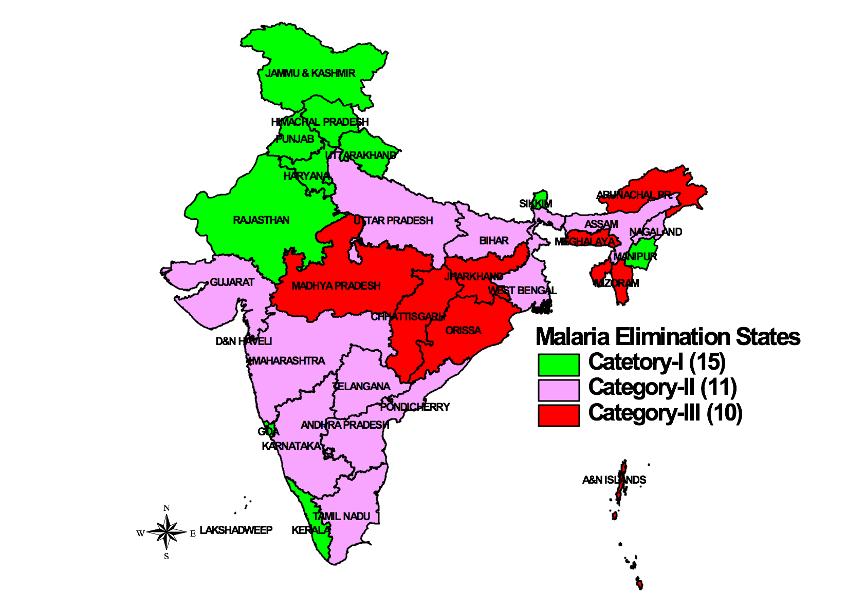
MALARIA ELIMINATION TARGETS
Category 1 (15)
-State/Districts reporting an API of less than 1 case per 1000 population
12079( 3%)
  Delhi, Goa, H P , J & K, Kerala, Lakshwadeep, Puducherry , Sikkim,
  ELIMINATE MALARIA BY 2020
Category 2 (11)
State < 1 API but some districts report API of 1 case per 1000 population
168573 (39%)
Andhra Pradesh, Bihar , Nagaland, Tamil Nadu, Telangana, West Bengal
ELIMINATE MALARIA BY 2022
Category 3 (10)
States with API of 1 or more per 1000 population
249276 (58%)
  Chhatisgarh, Dadra & Nagar Haveli, Jharkhand, Meghalaya,Odisha,
  Tripura
  ELIMINATE MALARIA BY 2024
By 2030 and beyond
  Prevent the re-establishment of local transmission of malaria in areas where it has been eliminated and maintain national malaria-free status

Slide 5
States contribution to malaria
Outbreaks reported in 2018 from UP and Tripura
Chhattisgarh, Jharkhand, West Bengal and UP – reporting maximum contribution

Slide 6
Key Issues
Make malaria notifiable- Bihar, Chhattisgarh, Jharkhand, Meghalaya, West Bengal, Delhi
Rapid Diagnostic Test Kits for early case detection at all levels, drugs, insecticides
Enhanced Surveillance– Formation of Rapid response teams and mock drills be initiated
States to fill all vacant positions – zonal entomologists and others
District wise actions plans by category 1 states(Delhi, Goa, H P , J & K, Kerala, Lakshwadeep, Puducherry , Sikkim – for Supplementary PIP

Slide 7
Key Issues - 2
Deaths due to DELAYED DETECTION
    2019 - Chhattisgarh (13), Odisha (4), Jharkhand (2), WB (1)
Gap in Vector control strategies -- Increase in malaria cases
    Chhattisgarh, Odisha, Tripura and Jharkhand
HBHI – High Burden High Impact Strategy in the States with WHO collaboration
    Chhattisgarh, Jharkhand and West Bengal –Secretaries may please review
Punjab – malaria elimination model being developed with WHO collaboration –to document and share with all states- ENSURE IMPLEMENTATION IN ALL DISTRICTS
Odisha and HP – to fully implement IHIP for malaria
MP – extend the Malaria Elimination Mandla Project to other districts

Slide 8
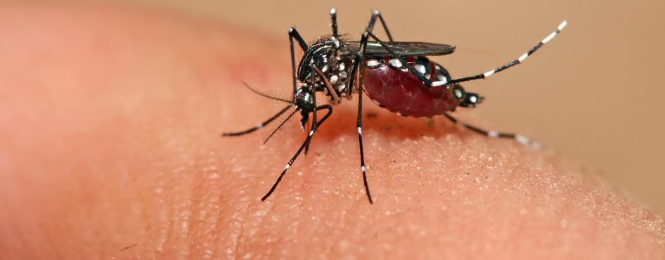
Dengue and Chikungunya

Slide 9
Dengue Epidemiological Situation
Country situation | 2016 | 2017 | 2018 | 2019 (Prov. till 8th Sept.)
Cases | 129166 | 188401 | 101192 | 32003
Deaths | 245 | 325 | 172 | 27
Comparative Dengue Cases till August from 2016 to 2019

Slide 10
Contribution by States: Dengue cases in 2019
(till 8th Sept.)
32003 Dengue cases

Slide 11
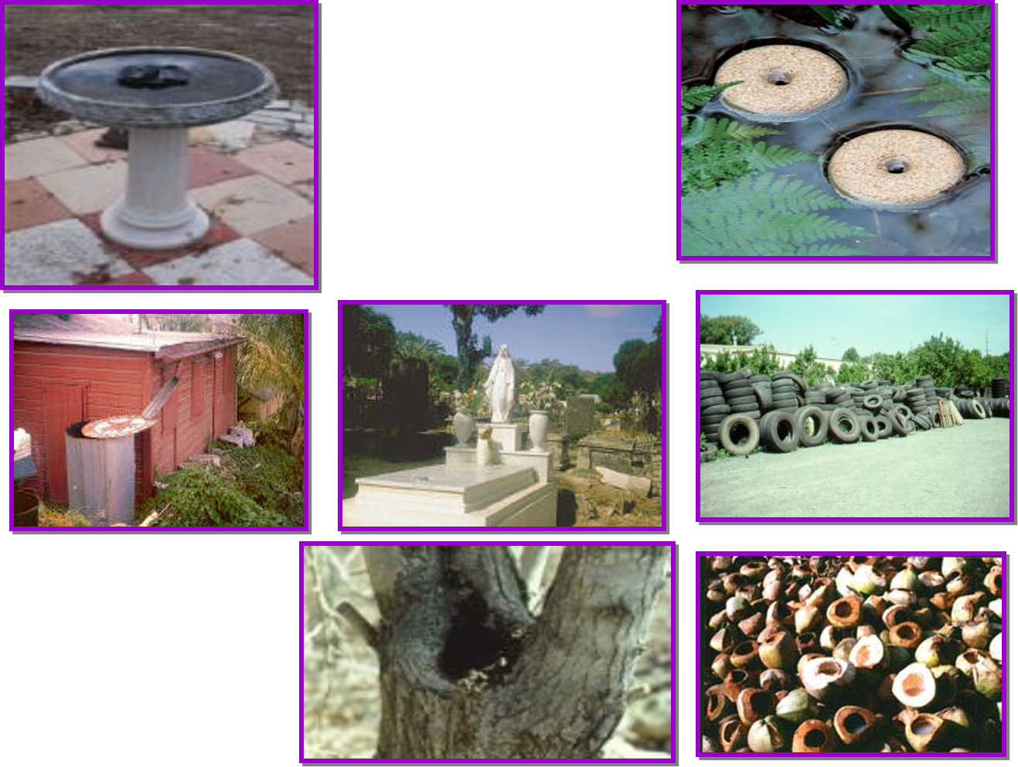
Key Issues
Large scale Dengue outbreak ongoing in neighboring countries – all States to keep a high alert
Attention needed in municipal corporations : Thiruvananthapuram, Hyderabad : collaborate with Urban department
3. Ensure GoI approved insecticides and vector control equipment in all districts

Slide 12
Key Issues - 2
4. Deployment of breeding checkers & ASHA s to keep vector density at low level – funds provisioned in PIP
5. Entomological surveillance- fill vacant posts of entomologists & insect collectors at state and zonal level
6. Ensure timely reporting of cases from private hospitals & laboratories to locate the transmission foci – Dengue is a notifiable disease
7. Train doctors on national guidelines to reduce deaths & complications in patients with life style diseases
8. Community awareness in campaign mode

Slide 13
Kala-azar Elimination
Target: Reduce annual KA case incidence to <1/10,000 population at block level by 2020

Slide 14
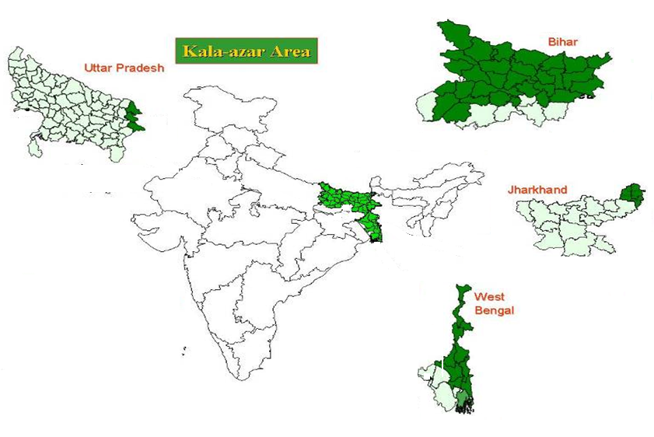
Kala-azar endemic states- INDIA
Disease endemic in 633 blocks of four states-
  Bihar (33 districts, 458 blocks)
  Jharkhand(6 districts, 22 blocks)
  West Bengal (11 districts, 120 blocks)
  Uttar Pradesh (6 districts, 22 blocks)

Slide 15
Kala-azar elimination status at block level 2017 to 2019
State | Number of endemic districts | Number of Endemic Blocks | Number of Blocks with >1case/10,000 pop
 |  |  | (2017) | (2018) | 2019 (Aug)
Bihar | 33 | 458 | 47 | 35 | 13
Jharkhand | 4 | 33 | 25 | 17 | 9
West Bengal | 11 | 120 | 0 | 0 | 0
Uttar Pradesh | 6 | 22 | 0 | 1 | 0
Total | 54 | 633 | 72 | 53 | 22
* Till Aug 2019, 13 blocks of Bihar (Saran-9, Siwan-3 and Gopalganj-1) and 9 blocks of Jharkhand (Pakur-4, Dumka-3 and Godda-2) have reported >1 KA case per 10,000 population

Slide 16
Major Initiatives
Action plan for KA formed till 2020, with clear roles and timeline for activities.
Dashboard Indicators developed for monitoring of the programme at National/State/District level
Number of meetings held with various partners for expediting the KA focus in high endemic villages – ACTION PLANS DEVELOPED.
Availability of drugs and diagnostics ensured. No stock out situation in the field
For Indoor Residual Spray (IRS)- Supply of quality Synthetic Pyrethroid ensured for next 4 rounds.
Field monitoring strengthened by NVBDCP Officers

Slide 17
Bihar and Jharkhand – activities to be undertaken
Ensure 6 rounds of Active Cases detection and treatment of each case
Focus on 244 villages in Bihar and 27 villages in Jharkhand consistently showing KA cases since 5 years – FOCUSSED SURVEILLANCE FOLLOWED BY TREATMENT OF ALL POSITIVES
Ensure strong follow-up – filling up of cards and follow up of defaulting patients
Relocate KTS and VBD consultants from low endemic to High endemic districts/blocks.

Slide 18
Bihar and Jharkhand – activities to be undertaken
Fill up vacant KTS posts in Bihar (38/186) and West Bengal (45/66).
Ensure Pucca houses in KA affected villages under PMAY-G
State Secretary to review on monthly basis the action taken by various partners and SPO in the States of Bihar, Jharkhand and WB and adherence to action plans developed
Extensive field visits by senior officers to high endemic areas

Slide 19
Lymphatic Filariasis
45% of Global burden with 10.63 lac cases
Target : DECREASE Mf RATE TO < 1 PERCENT by 2021

Slide 20
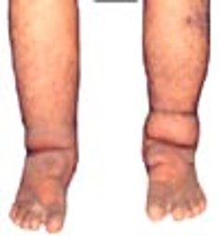
Geographical Distribution
256 districts are endemic in 21 States / UTs (Population at Risk: 63 Crore)
Out of 21 States, only 4 States/UTs (Puducherrey, Goa, Tamil Nadu and Daman & Diu ) have achieved elimination target
Out of 256 districts, only 96 districts have achieved elimination target (Microfilaria rate <1%)
143 /160 districts are in 8 States- Bihar, Jharkhand, Uttar Pradesh, Madhya Pradesh, Chhattisgarh, Odisha, West Bengal & Maharashtra
Notes:
Home based management of lymphoedema cases and up-scaling of hydrocele operations in the identified CHCs / District hospitals/ medical colleges.

Slide 21
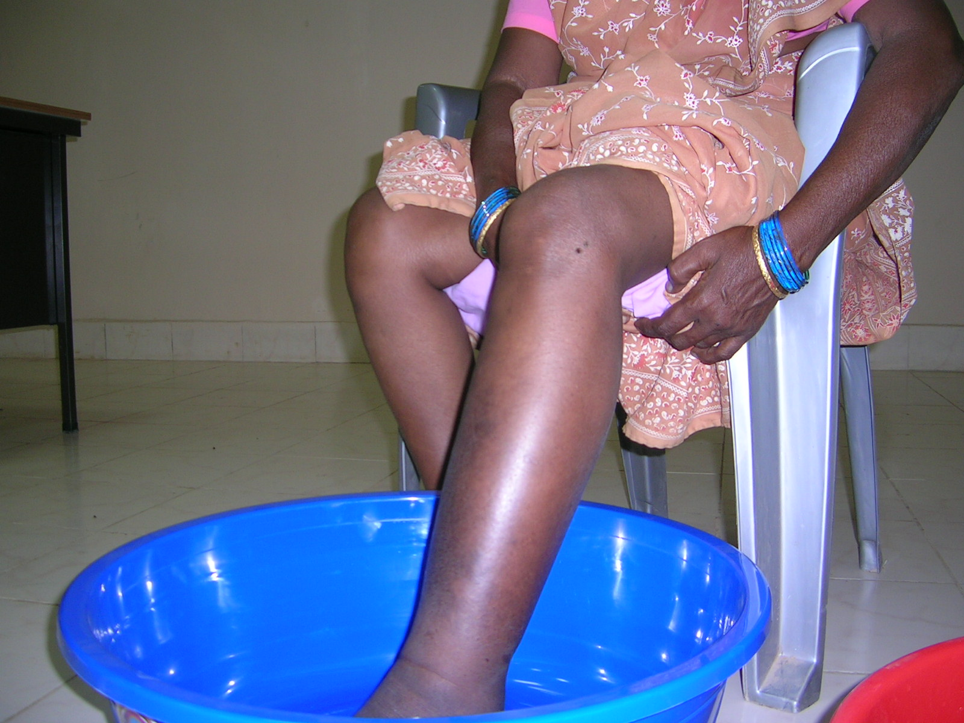
Elimination of LF- Stretegy
Twin Pillar Strategy:
  Mass Drug Administration (MDA)
  Morbidity Management & Disability Prevention (MMDP)
  160 districts under MDA, and need to achieve elimination target.
Notes:
Home based management of lymphoedema cases and up-scaling of hydrocele operations in the identified CHCs / District hospitals/ medical colleges.

Slide 22
Initiatives undertaken to Eliminate LF (1)
Accelerated Plan launched on 13th June 2018 in 10th Meeting of Global Alliance to Eliminate Lymphatic Filariasis (GALEF) in New Delhi
Triple drug (IDA), (DEC + Albendazole+ Ivermectin) Therapy implemented in following five districts:
  Arwal, Bihar: 20th Dec 2018
  Simdega, Jharkhand: 10th Jan 2019
  Varanasi, Uttar Pradesh: 20th Feb 2019
  Nagpur, Maharashtra: 20th Jan 2019
  Yadgir Karnataka: Scheduled in Nov. 2019
Benefit of IDA: Good coverage and compliance can eliminate LF within 2-3 years in comparison to 5-7 rounds of MDA
Notes:
Home based management of lymphoedema cases and up-scaling of hydrocele operations in the identified CHCs / District hospitals/ medical colleges.

Slide 23
Initiatives undertaken to Eliminate LF (2)
Prioritization of districts for scaling up of IDA
  11 districts of Uttar Pradesh are prioritized for IDA scheduled in November 2019
Increase in budget allocation for each component of the programme
Formation of technical Expert Committee for ELF
Ensured drug supply for MDA
State & Districts action plan has been circulated for compliance
Extra budget for ELF activity has been proposed
Revised financial norms for morbidity management of Lymphoedema case from Rs. 150/- to Rs. 500/
Increased Community participation, Social mobilization and advocacy through partners

Slide 24
Current Challenges and actions suggested
Drug Compliance a major issue- Promote supervised drug administration
HR availability and capacity for Night Blood Survey (NBS)
Social Mobilization & Community Participation – STATE SECRETARIES TO ENSURE ENGAGEMENT OF DIRTSICT COLLECTORS IN MDA – MASS MOVEMENT
MMDP – Hydrocelectomy and Lymphoedema Management
Preparation of microplan well ahead of MDA dates
Post MDA Assessment
Non endemic districts reporting LF cases – INITIATE MDA IN NEWER DISTRICTS
Vector Surveillance

Slide 25
Japanese Encephalitis (JE)/
Acute Encephalitis Syndrome (AES)

Slide 26
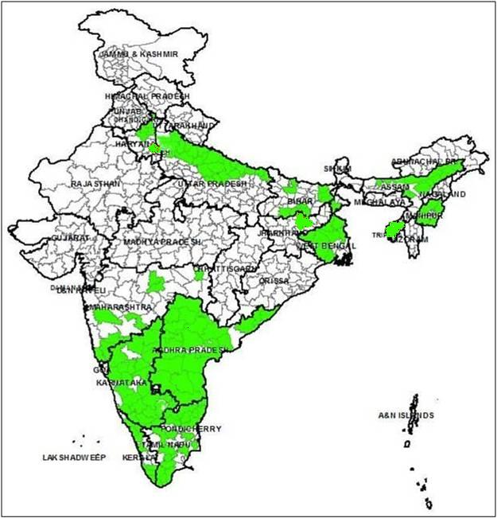
JE ENDEMIC STATES IN INDIA
JE affected States
Andhra Pradesh
Arunachal Pradesh
Assam
Bihar
Delhi
Goa
Haryana
Jharkhand
Kerala
Karnataka
Maharashtra
Manipur
Meghalaya
Nagaland
Odisha
Punjab
Tamil Nadu
Tripura
Telanagana
Uttar Pradesh
Uttarakhand
West Bengal
North Bengal districts 2014
Bihar
2000
Delhi 2011
Uttar Pradesh
1978
Assam
1978
Jharkhand
2011
Lower Assam districts
2014
Bankura & Burdwan
1973
Tripura
2013
Odisha
2012
Andhra Pradesh
1997
Kerala 2011
Vellore
1955
Number of Endemic Districts: 271 (22 States/UTs); Population: >400 million

Slide 27
State-wise Proportion JE cases – 2017 & 2018
2017
2018
22 out of 36 States/UTs in the Country are reporting JE/AES cases of these ~70% of disease burden is contributed by 5 States (Assam, Bihar, Tamil Nadu, Uttar Pradesh and West Bengal).

Slide 28
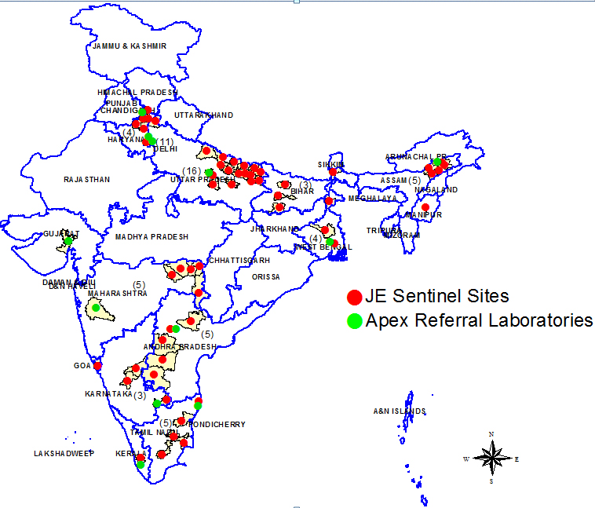
Surveillance activities: JE Sentinel Sites
Surveillance activities: JE Sentinel Sites
Sentinel Sites
1 | Andhra Prd | 3
2 | Arunachal Pradesh | 2
3 | Assam | 28
4 | Bihar | 7
5 | Chhattisgarh | 1
6 | Delhi | 12
7 | Goa | 3
8 | Haryana | 4
9 | Jharkhand | 3
10 | Kerala | 1
11 | Karnataka | 4
12 | Madhya Pradesh | 2
13 | Maharashtra | 5
14 | Manipur | 2
15 | Meghalaya | 5
16 | Mizoram | 1
17 | Nagaland | 1
18 | Odisha | 9
19 | Puducherry | 1
20 | Rajasthan | 3
21 | Tamil Nadu | 6
22 | Telangana | 2
23 | Tripura | 1
24 | Uttar Pradesh | 23
25 | Uttarakhand | 1
26 | West Bengal | 13
 | Total | 143
Apex Referral Lab.
1 | Chandigarh | 1
2 | Chennai | 1
3 | Delhi | 2
4 | Dibrugarh | 1
5 | Gujarat | 1
6 | Hyderabad | 1
7 | Kolkata | 1
8 | Kerala | 1
9 | Lucknow | 2
10 | Pune | 1
11 | Karnataka | 2
12 | Odisha | 1
 | Total | 15

Slide 29
Key Issues
The JE vaccination coverage should not be less than 80% under Routine Immunization (RI) – Poor convergence so far
Identify block wise list of leftover children and cover them by JE vaccination drives at block level.
States need to strictly follow the AES case definition for testing of JE on the patients CSF samples .

Slide 30
Key Issues (2)
Strengthen ASHAs for early referral of AES cases.
PICUs need to be made fully functional in the remaining high burdened districts(Assam-6 out of 10, Bihar-6 (15), Uttar Pradesh-11 (20) .
Physical medical Rehabilitation ( PMR) department to be made functional for JE disabled patients (Assam-0/2, Bihar-0/2, Uttar Pradesh 2/3, West Bengal 0/2)

Slide 31


Let the vector not defeat the State Might

Slide 32
Thank You

Slide 33
Technical Requirement of LLINs under DBS for FY 2019-2020 for saturation of sub-cemtres with API 1 and above and replacement of LLINs supplied during 2016
Sl. No. | Name State | Total Qty. in Nos
1 | A&N Islands | 10558
2 | Telangana | 26997
 | Telangana replacement* | 286000
3 | Bihar | 143837
4 | Goa | 92518
5 | Maharashtra | 976896
 | Maharashtra* replacement | 121000
6 | Gujarat | 1266437
 | Gujarat replacement* | 220000
7 | Haryana | 486628
8 | Andhra Pradesh | 2595645
 | A.P. Replacement* | 385000
9 | Tamil Nadu | 553374
10 | Odisha** | 2654301
11 | Rajasthan | 2217521
 | Rajasthan replacement* | 33000
12 | Karnataka | 303505
 | Karnataka Replacement* | 132000
Sl. No. | Name State | Total Qty. in Nos
13 | West Bengal | 151751
 | West Bengal replacement* | 220000
14 | Punjab | 76811
15 | Pudducherry | 1648
16 | Kerala | 22536
17 | Dadar & Nagar Haveli | 3340
18 | Uttarakhand | 9655
19 | Chhattisgarh replacement* | 770000
20 | Jharkhand replacement* | 1760000
21 | Madhya Pradesh Replacement* | 1507000
22 | Uttar Pradesh Replacement* | 66000
 | LLINl Requirement for saturation of sub-centres with API 1 and above | 11593958
 | LLIN supplied in 2016 to be replaced | 5500000
 | Total | 17093958

Slide 34
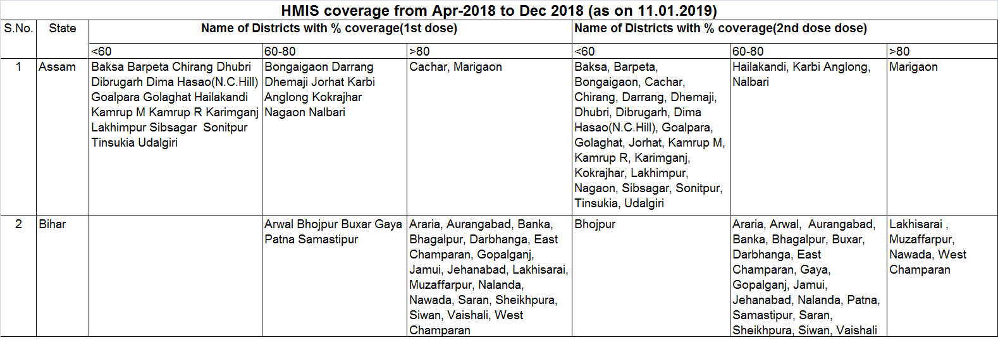
Vaccination status in Assam & Bihar
Districts already under immunization in Assam (28 districts) and Bihar (24 districts):
Districts newly identified for immunization in Bihar:
Bihar:
Katihar, Kishanganj, Madhepura, Madhubani, Munger, Purnia, Rohtas, Saharsa, Sheohar, Sitamarhi, Supaul.

Slide 35
District reporting highest number of AES/JE cases and deaths in 2019 (till 30.06.2019), Vaccination coverage and PICU status in Assam and Bihar
State | District | AES |  | JE |  | Vaccination coverage
 |  | Cases | Deaths | Cases | Deaths
Assam | Kamrup R | 25 | 3 | 11 | 3 | 52%
 | Jorhat | 46 | 11 | 9 | 6 | 44%
 | Dibrugarh | 41 | 2 | 6 | 2 | 47%
 | Lakhimpur | 43 | 1 | 5 | 1 | 55%
Bihar | Muzzafarpur | 437 | 91 | 26 | 4 | 85%
 | E.Champaran | 84 | 22 | 5 | 0 | 80%
 | Sitamarhi | 27 | 10 | 1 | 0 | planned in Oct 2019
PICU Status
 | State | Status | Districts | Remarks
1 | Assam (10) | Functional (4) | Dibrugarh, Golaghat, Lakhimpur and Sibsagar | --
 |  | Others (6) | Dhemaji, Tinsukia and Udalgiri | Proposed for approval of Civil works
 |  |  | Barpeta, Jorhat and Sonitpur | Not initiated
2 | Bihar (15) | Functional (2) | Muzaffarpur and Patna | --
 |  | Others (13) | Darbanga, East Champaran, Gaya, Nawada and Vaishali | Purchase of Equipments under process
 |  |  | Aurangabad, Gopalganj, Jahanabad, Nalanda, Samartipur, Saran, Siwan & West Champaran | Not initiated

Slide 36
Thanks

Slide 37
Seasonal trend of Dengue cases in India 2015-2019
(Prov. till Aug)
Cases increase during monsoon and peak transmission is observed September and October.
    Ensure vector/larval control measures- effective Aedes breeding to be checked on weekly basis
Transmission is perennial in southern and western parts of the country

Slide 38
Main districts affected

Slide 39
Year- wise Chikungunya Cases
(Prov. till 31st Aug.)
15 % decrease in 2018 compared to corresponding period in 2017
No death due to Chikungunya since last 12 years

Slide 40
AES & JE cases in India 2008-2019 (till 15th Sep 2019)
Of the total AES cases, 11–14% are due to JE. Other causes of AES are Scrub Typhus, Leptospirosis, Herpes, West Nile, Dengue, Bacterial Meningitis, Malaria.
Case Fatality Ratio of AES cases declined from 8.0% in 2017 to 5.6% in 2018.
Case Fatality Ratio of JE cases declined from 11.6% in 2017 to 10.8% in 2018.
Number of Sentinel sites increased from 51 in 2005 to 143 in 2019 till date.
1552 JE cases and 176 deaths have been reported till 15.09.2019.

Slide 41
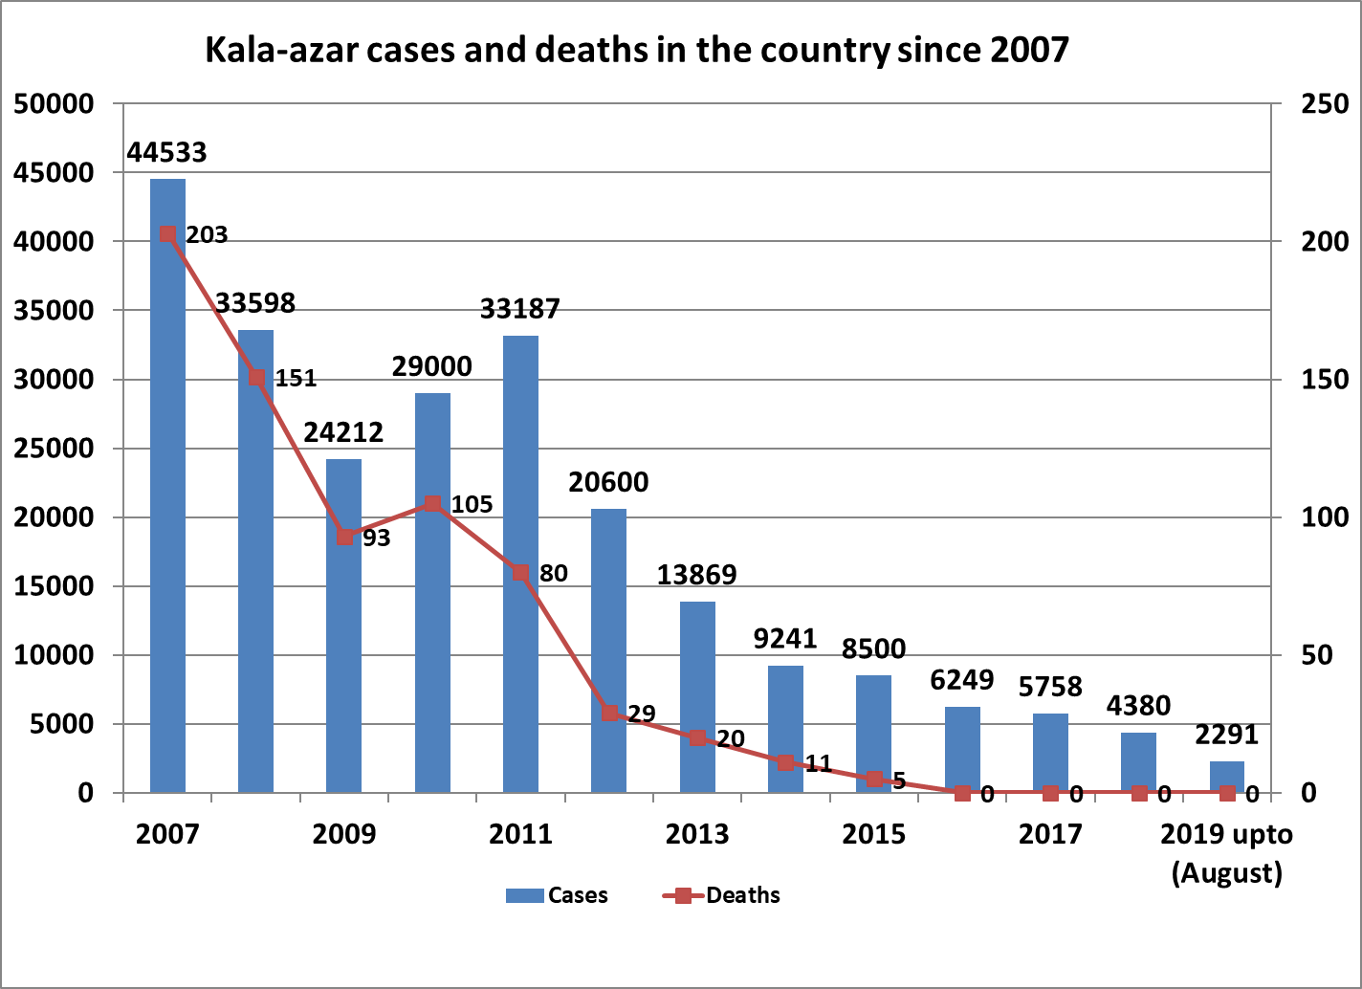
29% reduction in number of Kala-azar cases till August2019 as compared to August2018

Slide 42
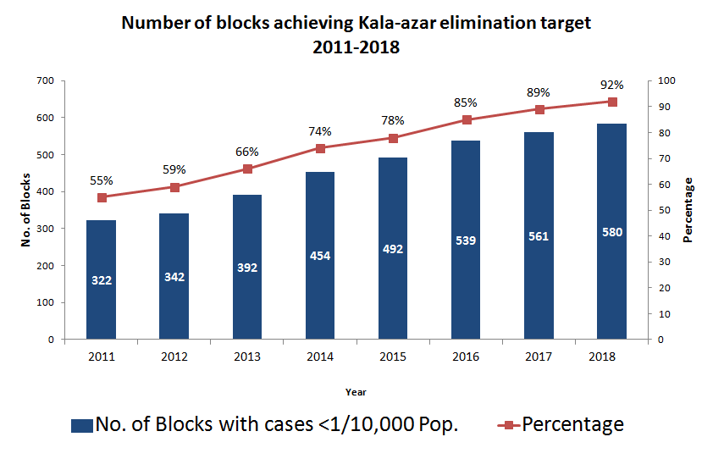
53 (8%) blocks reported >1 KA case/10,000 population at block level
      Bihar (35),
      Jharkhand (17) BRING DOWN TO <1 PER 10,000 BY 2020
      and UP (1)

Slide 43
LF Burden in India in comparison to Global Burden
Attributes | Global Burden | India Burden
Population at risk | 1.4 Billion | 0.63 Billion (~45% of global burden)
No. of Countries/ States | 73 Countries | 16 States + 5 UTs (256 Districts (IU)
Population with Disease manifestation | 40 Million | 1.3 Million
Hydrocele | 25 Million | 0.4 Million
Lymphoedema | 15 Million | 0.9 Million

Slide 44
LF – Comparative Situation in India
2004 – 256 dist. (IU)
2019 – 160 dist. (IU)
*96 districts have achieved <1% MF rate/district

Slide 45
8 States (Bihar, Jharkhand & Uttar Pradesh, Madhya Pradesh, Chhattisgarh, Odisha, West Bengal & Maharashtra ) contribute maximum burden
Parameters | National | 8 States | %
Endemic districts | 256 | 176 | 69
Population (2019) (in millions) | 630 | 500 | 75
MDA districts (2019) | 160 | 143 | 90

