Slide 1
Review Meeting with States/UTs
19th-20th September, 2019
Ambedkar Bhawan, Janpath Road,
New Delhi

Slide 2
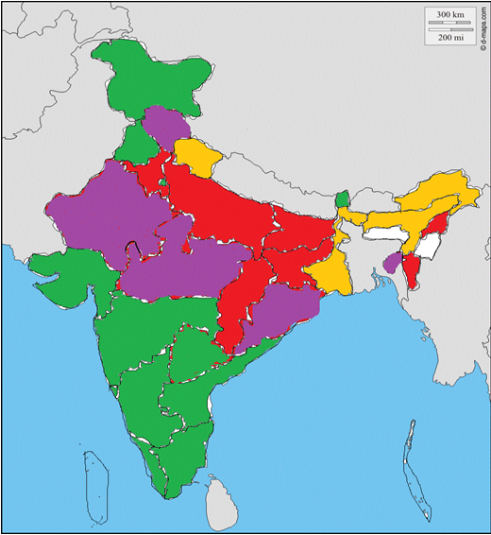
Availability of Doctors (per Lakh population)
WHO RATIO 100000:100
100+
80-99
60-79
40-59
Below 40

Slide 3
Availability of Medical Education (UG seats per Lakh population)

Slide 4
Availability of Medical Education (PG seats per Lakh population)

Slide 5
National Medical Commission (NMC) Act, 2019
The National Medical Commission will be constituted in place of Medical Council of India.
As per section 11 of the NMC Act, 2019, there will be a Medical Advisory Council.
All the States, MHA (for UTs) and State/UT Medical Councils have been requested to nominate representatives for the Medical Advisory Council.
On receipt of the nominations, the Ministry will finalize constitution of the National Medical Commission and Medical Advisory Council.

Slide 6
CSS For New Medical Colleges – Phase-III
Phase-III approved - establishment of 75 new medical colleges.
Districts where there are no medical colleges.
Estimated cost per medical college is Rs.325 crore.
Selection on challenge mode
Preference to aspirational districts.
District Hospitals/Referral Hospital having bed strength of 200 or more.
States/UTs have been requested to send proposals.
UCs pending under the 3 Centrally Sponsored Schemes.

Slide 7
EWS Quota in Medical Courses
10% EWS reservation in Government or aided medical colleges.
5200 MBBS seats increased in 2019-20.
Karnataka and Tamil Nadu have not applied this year.
BoG has decided that for PG courses EWS quota may be implemented from the AY 2020-21 onwards. State Governments may apply for increasing of PG seats under EWS Quota in the format prescribed by BoG.

Slide 8
Increasing availability of faculty.
Equated Designation.
Floating designation.
Engagement of regular faculty.
Engagement of retired faculty.
Attractive remuneration.
Promoting DNB courses.
Suitable HR policies.

Slide 9
Conversion of PG diploma seats to Degree seats
Medical colleges can apply to the Ministry for conversion of recognized PG Diploma seats into degree seats in light of BOG-MCI’s notification dated 12.07.2018.
Normally granted without inspection.
Undertaking to be given to stop admission in Diploma courses.
2148 Diploma Seats were converted in 115 Colleges in 2019-20.
Last date for permission is 28.02.2020.
State may submit applications by 31.10.2019 to allow BoG to decide in time and avoid re-notification of Diploma courses.

Slide 10
Expansion of CPS courses
10 CPS courses have been included in the First Schedule of the IMC Act, 1956.
Increased availability of sub-specialist doctors.
50%-100% reservation for in-service doctors.
All the admissions to CPS courses are being made on the basis of NEET (PG).
Dte.GHS will conduct counseling for admission to CPS courses from the academic year 2020-21.
Representatives of MoHFW, MCI, Dte.GHS and State Government of Maharashtra have been included in Governing Body of CPS.
All the States / UTs have been requested to consider to run CPS courses in District Hospitals.

Slide 11
Expansion of DNB courses
National Board of Examination (NBE) grants PG medical qualifications namely DNB equivalent to MD/MS/DM/MCh.
Increased availability of specialist doctors/medical faculty.
50% reservation for in-service doctors.
Ministry vide letter dated 28.02.2019 requested State Governments for starting DNB courses in the district hospitals managed by States and in Municipal Hospitals
The matter was also discussed in Video Conference by Secretary (HFW) on 23.04.2019 with States/UTs and in the meeting of JS with States on 02.04.2019.

Slide 12
Problem of Quacks
Health is a State subject, the responsibility to deal with cases of quacks lies with the respective State Governments.
The Central Government in August 2017 requested Chief Ministers of States to take appropriate action under law against quacks and also to evolve suitable policies to ensure availability of quality health workforce in rural areas.
Further, in February, 2018, Chief Secretaries of the all the States / UTs have also been requested to take corrective steps in this regard.
Action taken report in the matter is still awaited from the States/UTs.
Increased penalties in the National Medical Commission Act, 2019.
Community Health Providers under NMC Act will have limited licence to practice medicine at mid-level health care. They will be qualified professionals from modern medicine with eligibility criteria as may be prescribed.

Slide 13
NURSING
Compliance of the recommendations on pay and working conditions of nurses working in private hospitals, etc. by State Governments as per Supreme Court directions.
Single Entry Level for Nursing by Phasing out of GNM Course by 2021-22 onwards.
Establishments of State Nursing Cells: UCs/ Status awaited
Upgradation/Strengthening of Nursing Services (ANM/GNM)- UCs pending from States.
Development of Nursing Services (DNS) : Funds released to 17 Institutions: UCs pending from States

Slide 14
ALLIED HEALTH SERVICES
Setting Up Of State Institutions Of Paramedical Sciences In States And Setting Up Of Colleges Of Paramedical Education: UCs pending from 5 States i.e., Maharashtra, Rajasthan, Kerala, Tripura and Jharkhand
Schemes of Strengthening/ Upgradation Of Pharmacy School/ Colleges: UCs pending from 7 States i.e., Kerala, Tamil Nadu, Orissa, Uttar Pradesh, Uttarakhand, West Bengal and Assam.
Proposals awaited from Andhra Pradesh and Madhya Pradesh for Pharmacy Scheme.

Slide 15
ALLIED AND HEALTHCARE PROFESSIONS BILL, 2018
Allied and Healthcare Professions (AHP) – involved in modern medicines/ health related services, with expertise in delivery of therapeutic, diagnostic, curative, preventative, rehabilitative interventions.
Allied and Healthcare Professions Bill 2018- introduced in Rajya Sabha on 31st December 2018 – Stands referred to Parliamentary Standing Committee for examination.
Bill provides for regulation and maintenance for standards of education and services by Allied and Healthcare professionals.
The Bill envisages development of minimum standards of education, courses, curriculum, facilities, examination, training, etc.
The Bill covers more than 50 professions such as Physiotherapist, Optometrists, Nutritionists, etc. in 15 broad categories.

