Slide 1
Ministry Of Health & Family Welfare
eHealth Initiatives

Slide 2
Digital Health Vision
VISION: Interoperable Electronic Health Record of every citizen
1
2
3
4
Intergated Platform
Free To Use Software/ Applications
Free & Secure Data Storage
Data Aggregation ‘Big Data And Analytics
Create EHR of 1.3 billion people with pan-India exchange in secured manner
Set-up pan-nation Telemedicine Network
Optimal use of IT for pan-nation surveillance & monitoring of programs
Efficient use of IT tools for capacity building & training
Wide-scale deployment of IT tools for governance & information dissemination

Slide 3
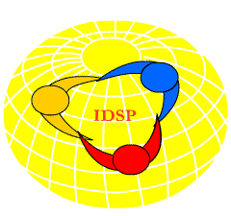
eHealth Activities
Integrated Disease Surveillance Program (IDSP)/IHIP
Revamped the Integrated Disease Surveillance Program (IDSP) & launched an updated application with name IHIP
Data entry from more than 2 lakh facilities covering 33 epidemic prone diseases for surveillance of disease predicting early outbreaks with advanced GIS mapping.
Tele-medicine services in Health & Wellness Centres (HWCs)
Implementation of telemedicine services in 1.5 lakhs HWCs
Guidelines issued to all States/UTs under NHM
National Workshop on eSanjeevani Telemedicine application held on 17th September 2019

Slide 4
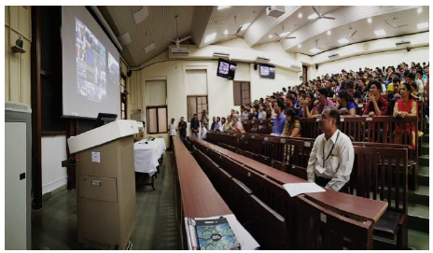
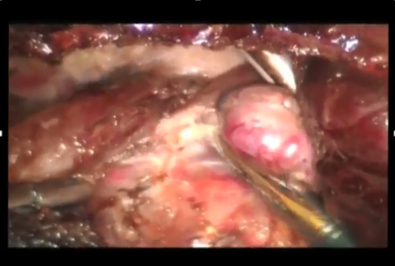
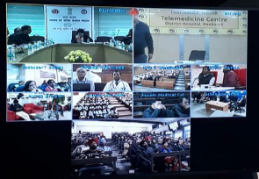
eHealth Activities
Comprehensive Primary Healthcare Program (CPHC-NCD)
CPHC-NCD developed for population based screening for 5 Non-Communicable Diseases - Hypertension, Diabetes, 3 common cancer (Oral, Breast and Cervical)
National Medical College Network (NMCN)
50 Govt. Medical Colleges networked
20 states actively updating data on portal/mobile app
From Nov 2018 to April 2019- 8 crore enrolments done and close to 1.3 crore screened
Tele-Education, Remote learning, live surgery, CME
Operational in 49 colleges
Collaboration network for Doctors/Students

Slide 5
eHealth Activities
Tele-Radiology (CORS)
Providing remote Radiology services to PHC/CHC/DH from State/Central Medical Colleges
My Health Record System – PHRMS
Enable the citizens to manage their own medical records in a centralized way
Web based access for Radiologists and Medical Officers
Implemented in 90+ HFs
Facilitate the storage, access and sharing of personal health data.
Alerts for medications, appointments and other wellness parameters
Provision to add discharge summary and lab report
Storage linked with Digital Locker

Slide 6
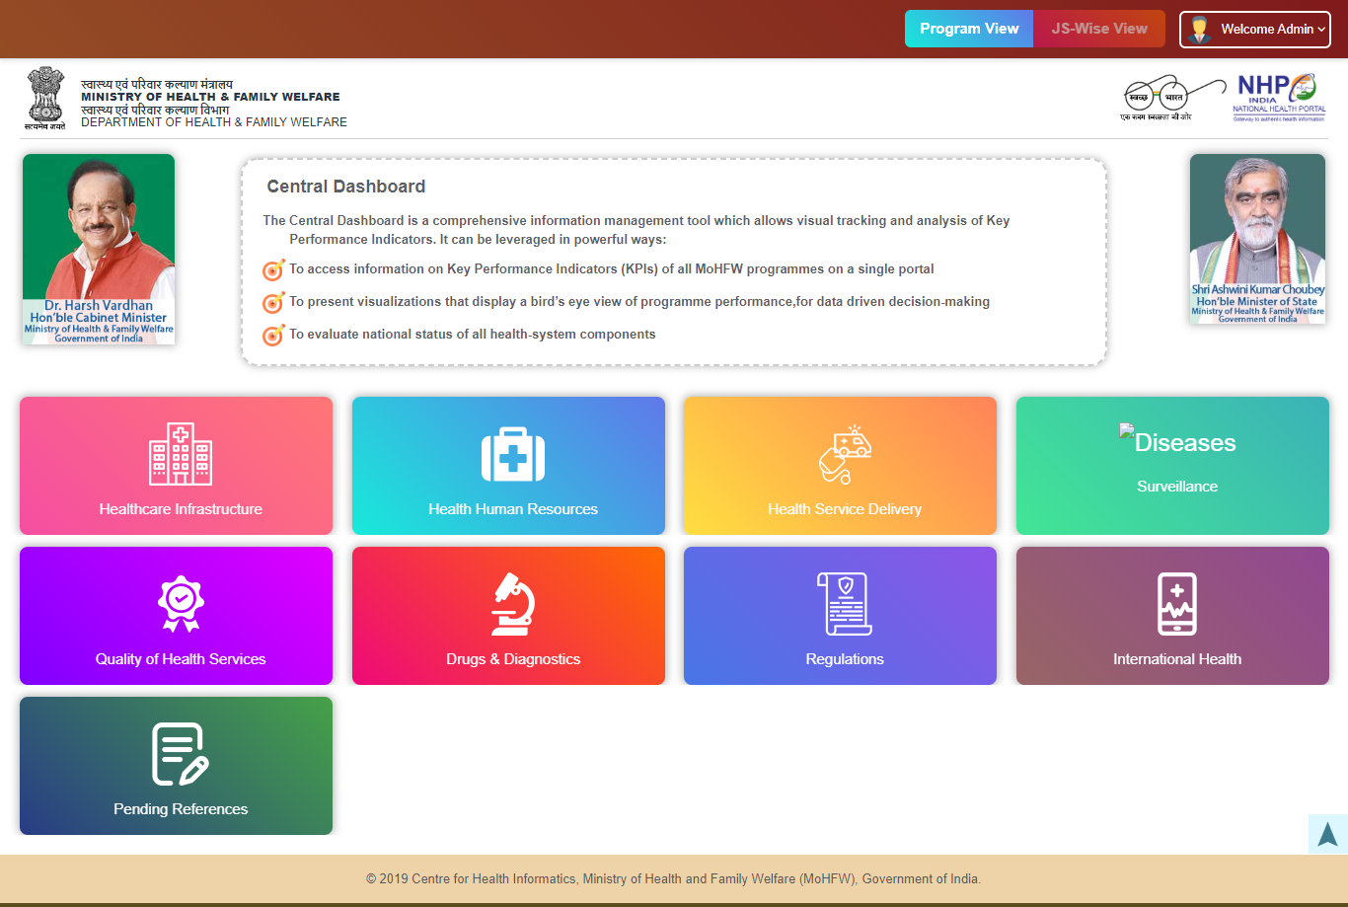
eHealth Activities
Dashboards/Portal
Health and Wellness Centers (HWC)
Laqshya,
National Programme for Health Care of Elderly (NPHCE)
Mental Health website and Dashboard
Emergency Medical Response (EMR) website and Dashboard
MoHFW Budget.
National Health Policy-2017
Pradhan Mantri Swasthya Suraksha Yojana
International Health (IH/IC)
Central Dashboard

Slide 7
Current challenges in Health IT
Fragmented information streams/systems
Digital interventions like MCTS,RCH,NIKSHAY, e-Hospital, e-Shushrut, PMJAY etc. captures patient data but operates in siloes
Data is inaccessible, improperly formatted/not standardised and hence not interoperable
Duplication of data collection – Data Redundancy due to non-communication between various application
No Health Information Exchange – due to lack of unique identifiers for patients, providers & health facilities across systems
Lack of common data analytics platform.
It is essential that information should be accessed from anywhere in the health system to facilitate seamless communication in between different systems.
Data should only be recorded once, at its source (single instance capture), the systems need to be sustainable, data must be standardised and understandable and the system needs to be available locally with a strengthened data protection policy

Slide 8
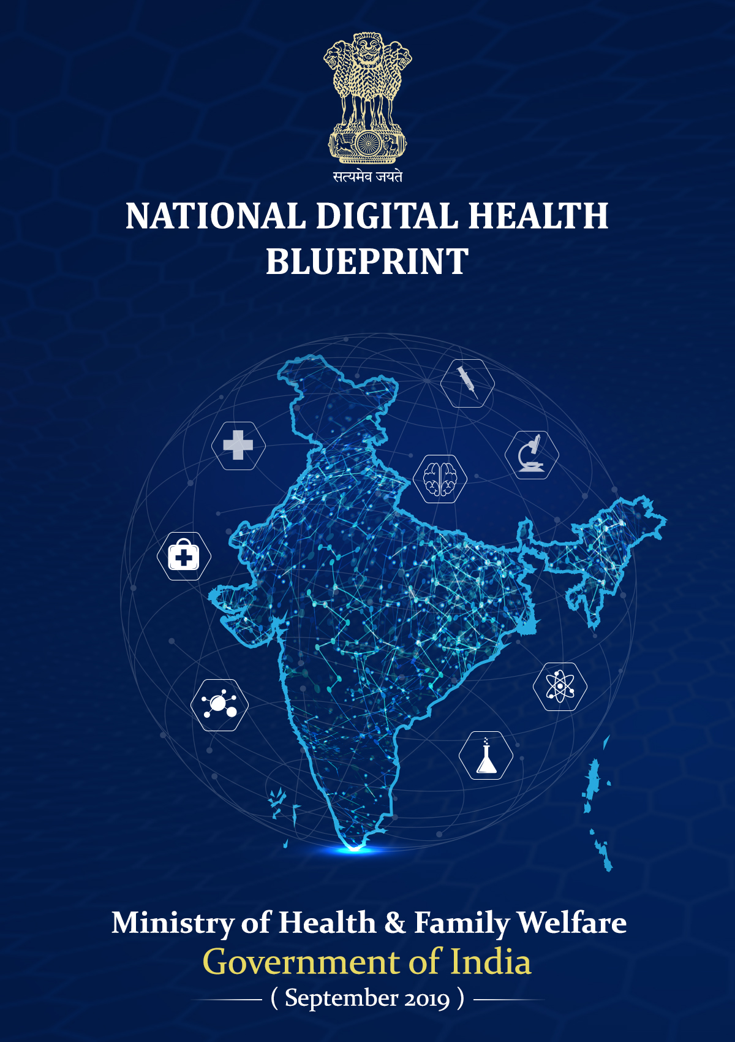
eHealth Activities
National Digital Health Blueprint (NDHB)
5-layered system of architectural building blocks
Unique Health Identifier (UHID)
Privacy and consent management
National portability
EHR, applicable standards and regulations
Health Analytics, proposing AI/ML/Blockchain technologies
Multiple access channels like web, mobile, call centre, telemedicine, Digital Health India portal and MyHealth app
National Architectural Framework
Federated architecture, open standards
Converging disparate health information systems

Slide 9
eHealth Activities
Hospital Information System (HIS)
Currently, Implementation status:
Standards
Notified revised Electronics Health Record (EHR) Standards 2016
eHospital application(NIC): more than 300 Hospitals
Provided financial support under NHM to 22 States /UTs in last 5 years
eSushrut application (C-DAC) : more than 80 Health Facilities in Rajasthan and Maharashtra
Established National Resource Centre for EHR standards (NRCeS) for adoption and promotion of standards.
Notified Health Metadata & Data Standards (MDDS) in August 2018
Clinical data – creation of EHR

Slide 10
eHealth Activities
Online Registration System (ORS)
Facilitate online registration & appointment in public hospitals
Mera Aspataal - MyHospital
IT based patient feedback system
Online viewing of test reports, blood bank availability
Currently more than 230 hospitals on-boarded
multi-channel approach to collect information on patients’ level of satisfaction- Short Message Service (SMS),
Outbound Dialling, Web Portal, Mobile App
Currently, more than 3200 hospitals are covered

Slide 11
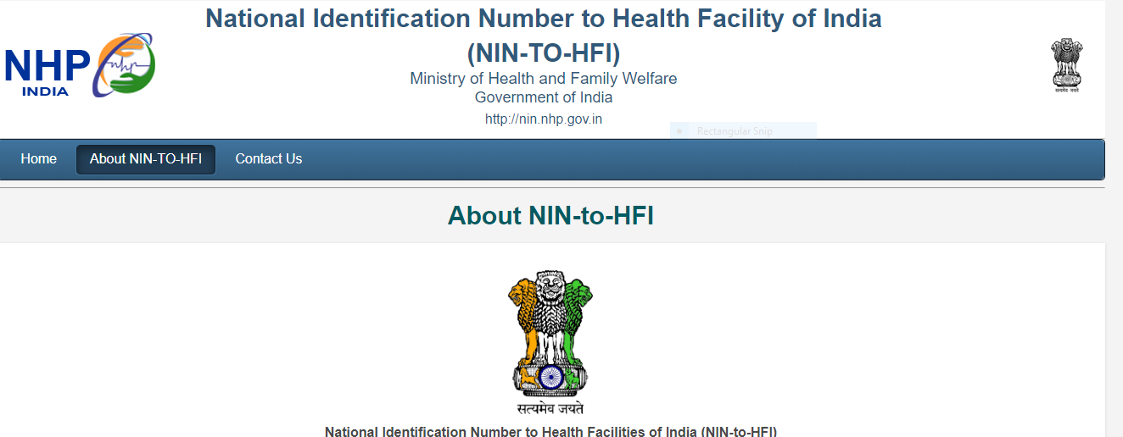
eHealth Activities
National Identification Number (NIN)
a unique identification number & key requirement for achieving inter-operability and creation of EHRs
National Health Resource Repository (NHRR)
With vision to create a comprehensive & robust registry with details on Infrastructure, Services, Patient Load, GIS, manpower, equipment for all public and private health facilities
~ 99 % of Public Health Facilities allocated NIN
~ 25 Lakh health facilities to be covered across country; Currently 60% health facilities successfully verified with over 1400 data sets per facility.

Slide 12
eHealth Activities
Digital Payment
A flagship programme of the GoI with a vision to transform India into a digitally empowered society and knowledge economy
Advisories issued to all States/UTs, Central Government and Autonomous Hospitals to enable the Digital Payment touch point in each health facilities
Developed a Digital Payment portal for monitoring, status update and IEC activities

Slide 13
Expectation from States..
States to propose plan for implementation of Hospital Information System (HIS) (eHospital & eShushrut), Mera Aspataal and ORS covering all facilities till CHC.
IHIP - Ongoing 7 states to ensure data from all facilities , 15 new states to undertake training and launch the software early. Remaining states to be also on boarded as per the interest from states.
States to finalize the location of HUB and HWCs for Tele-medicine services under HWC programme and submit proposal under NHM. Hire manpower in Hub, procure hardware and initiate trainings.
States to initiate rollout of Tele-Radiology service (CORS) in health facilities
State to increase the utilization of NMCN infrastructure in consultation with ME department (State/MoHFW) and Regional Resource Centers (RRCs)
States to propose IT applications for implementation of EHR standards in consultation with CDAC-Pune
States/UTs are not updating Digital Payment data on MoHFW Dashboard. States to update data on monthly basis.

Slide 14
THANK YOU

Slide 15
Financial support for HIS implementation
SN | State | 2014-15 (in Lakhs) | 2015-16 (in Lakhs) | 2016-17 (in Lakhs) | 2017-18 (in Lakhs) | 2018-19 (in Lakhs) | 2019-20 (in Lakhs)
1 | Rajasthan | 334 | 250 | 597 | 829.14 | 967.11 | 2121.85
2 | Tamil Nadu | --- | 1477 | 400 | 4085.94 | 4000 | 4000
3 | Karnataka | --- | 3150 | 0 | 965.03 | 5087.91 | 1346.49
4 | Uttar Pradesh | 113 | 236 | 3000 | - | 5256.4 (100 SDH) | 430.76
5 | Bihar | - | - | 4 | - | 3508 | 4008.10
6 | Gujarat | 8 | 8 | ---- |  | Nil
7 | Maharashtra | 268 | 0 | 3000 |  | Nil | 770
8 | Himachal Pradesh | 35 | 35 | 35 | 58.2 | 35 | 45.40
9 | Jammu & Kashmir | 95 | --- | 194 |  | 269.8
10 | Assam | --- | 0 | 0 | 250 | 125 | 84
11 | Meghalaya |  |  | 212 | 124.76 | 36.49 | 21.13
12 | Jharkhand |  |  | 132 |  | 134.54 (23 DH, 13 SDH)
13 | Tripura |  |  | 590.09 |  | 340.16 (21 DH) | 136.66
14 | West Bengal |  |  | 5.31 | 100 | Nil
15 | Uttarakhand |  |  | 99.40 |  | Nil
16 | Nagaland |  |  |  | 100
17 | Telangana |  |  |  | 3981.46 | Nil
18 | Punjab |  |  |  | 500 | Nil
19 | Delhi |  |  |  |  | Nil
20 | Kerala |  |  |  |  | 3458 | 2497.94
21 | Madhya Pradesh |  |  |  |  | Nil | 70
22 | Puducherry |  |  |  |  | Nil | 78.34
 | Total | 3862 | 6696 | 10318 | 10995 | 23218.41 | 15610.67
Back

